Slide 3
CARE LISTENING FORUM QUESTIONNAIRE
Please circle one of the following to the statement:
1. Are you currently:
a. Teaching in Stratford
b. An administrator in Stratford
c. Tutoring in Stratford
d. Formerly any of the above
e. Retired
f. Other
2. Do you feel that Stratford schools are:
a. Urban
b. Suburban
c. Other

Slide 4
3. Have you seen the demographic changes in the
Stratford school population?
a. Yes
b. No

Slide 5
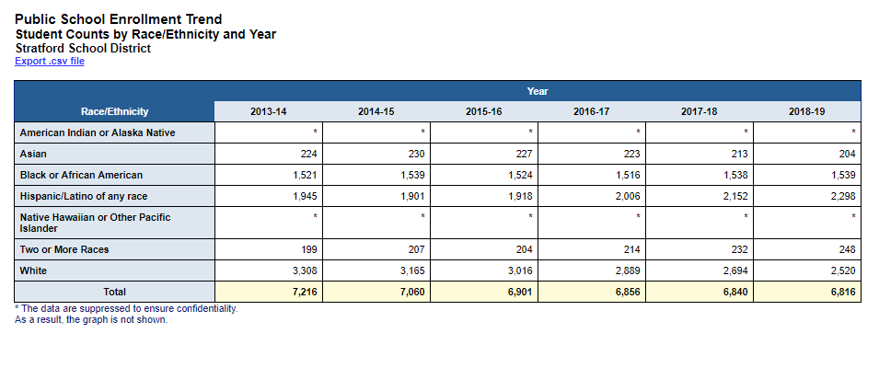
-20
+18
+353
+49
-788
-400
http://edsight.ct.gov/SASPortal/main.do

Slide 6
4. Circle the percentage of students of color which you feel best represents the current demographics of the Stratford School System:
a. 12%
b. 25%
c. 38%
d. 46%
e. 64%

Slide 7
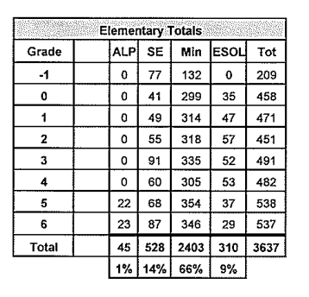
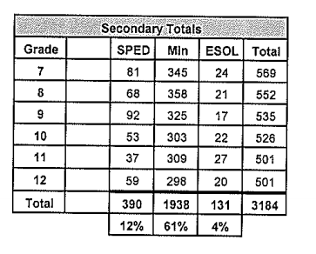
Enrollment as of April 2019 per SBOE website
https://www.stratfordk12.org/uploaded/District/Board_of_Education/BOE_minutes_agendas/2018-2019_Min_Agenda/April_Enrollment_2019.pdf

Slide 8
5. What percentage of Stratford school teachers do you believe are teachers of color?
a. 3%
b. 7%
c. 15%
d. 28%
e. 36%

Slide 9
http://edsight.ct.gov/SASPortal/main.do

Slide 10
6. Do you feel that the Stratford School System is open to the ideas / suggestions of educators, parents and the public?
a. Yes
b. No
c. Somewhat

Slide 12
7. Do you believe that there is an achievement gap within the Stratford School System between white students and students of color?
a. Yes
b. No
c. Not-Certain

Slide 13
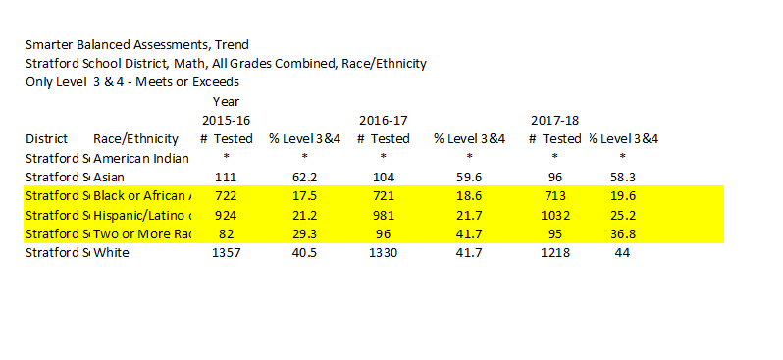
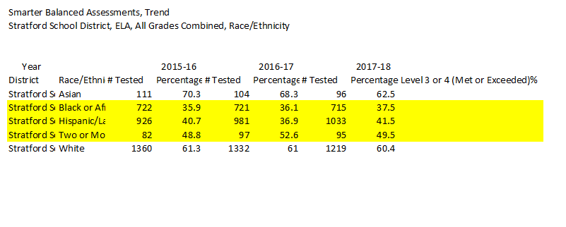
Math
ELA
http://edsight.ct.gov/SASPortal/main.do

Slide 14
8. How would you rate the Stratford School System:
a. Poor
b. Fair
c. Good
d. Very Good
e. Excellent
9. Overall, did you have a professionally satisfying experience working in the
Stratford School System?
a. Yes
b. No
c. N/A Comments (Use the reverse side if necessary):

Slide 16
Breakout Group Session
How can we attract minority teachers to Stratford Public Schools?
How can we support the retention of minority teachers?
How can we narrow the achievement gap?

Slide 17
Guiding Questions
The following are suggested guided questions that you might use to spur discussion in your small group. Please try to address question 1 and 2. If one question seems to be the major interest of the group, feel free to spend most of your time there. There will be one facilitator and note taker at your table. Choose one person to report out the top 3 ideas or discussion points from the group to the larger group. All ideas will be kept as data
How can schools attract teachers of color?
What are the issues acting as barriers to finding, recruiting and supporting teachers of color.
Have you had personal experiences or observed systems issues that can be remedied so that more minority teachers are hired and stay in the Stratford School System?
Have you found any resources that might be helpful or informative as the system grapples with these issues?
Based on the information and data you have seen today, can you suggest any ideas that might help narrow the minority achievement gap.
Have you had any personal experience attempting to narrow the gap
What did you experience
Have you found any resources that might be helpful or informative as the system grapples with these issues?

Slide 18
How can schools attract teachers of color?
What are the issues acting as barriers to finding, recruiting and supporting teachers of color.

Slide 19
How can schools attract teachers of color?
Have you had personal experiences or observed systems issues that can be remedied so that more minority teachers are hired and stay in the Stratford School System?

Slide 20
How can schools attract teachers of color?
Have you found any resources that might be helpful or informative as the system grapples with these issues?

Slide 22
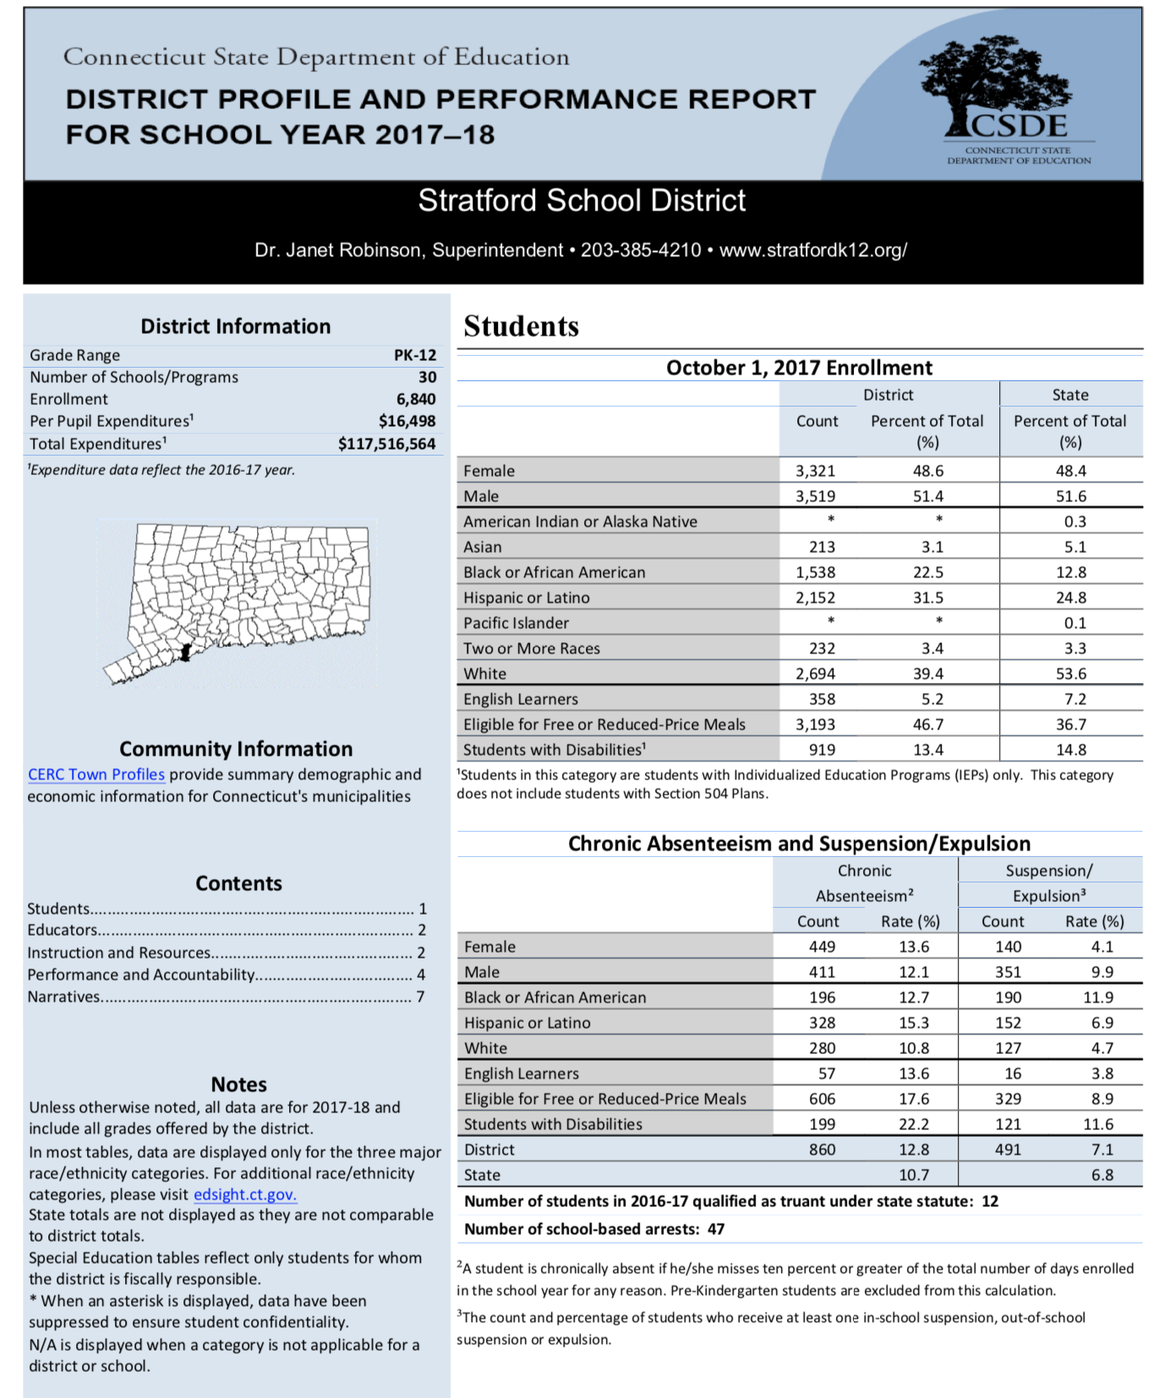
2017-18 Student Percentage
White 39.4
Hispanic or Latino 31.5
Black or African American 22.5
2 or more Races 3.4
Asian 3.1

Slide 23
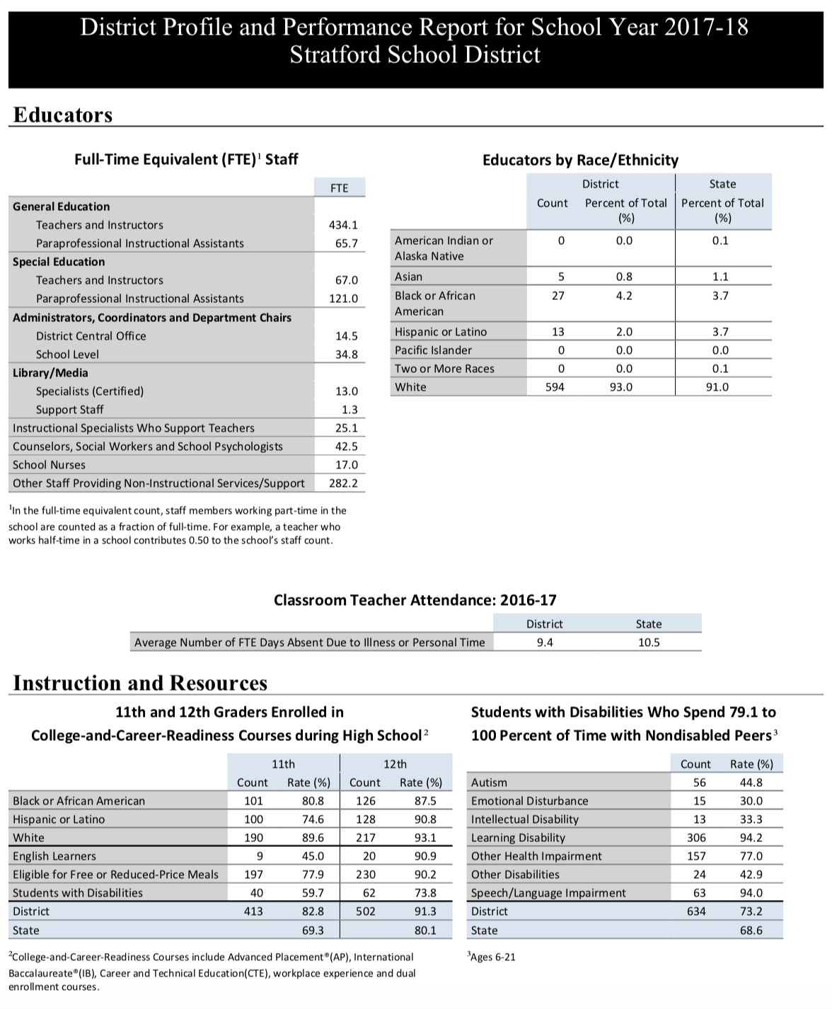
Enrolled in College & College Readiness Courses
11th Grade
White 89.6
Black 80.8
Hispanic 74.6
12th Grade
White 93.1
Hispanic 90.8
Black 87.5

Slide 24
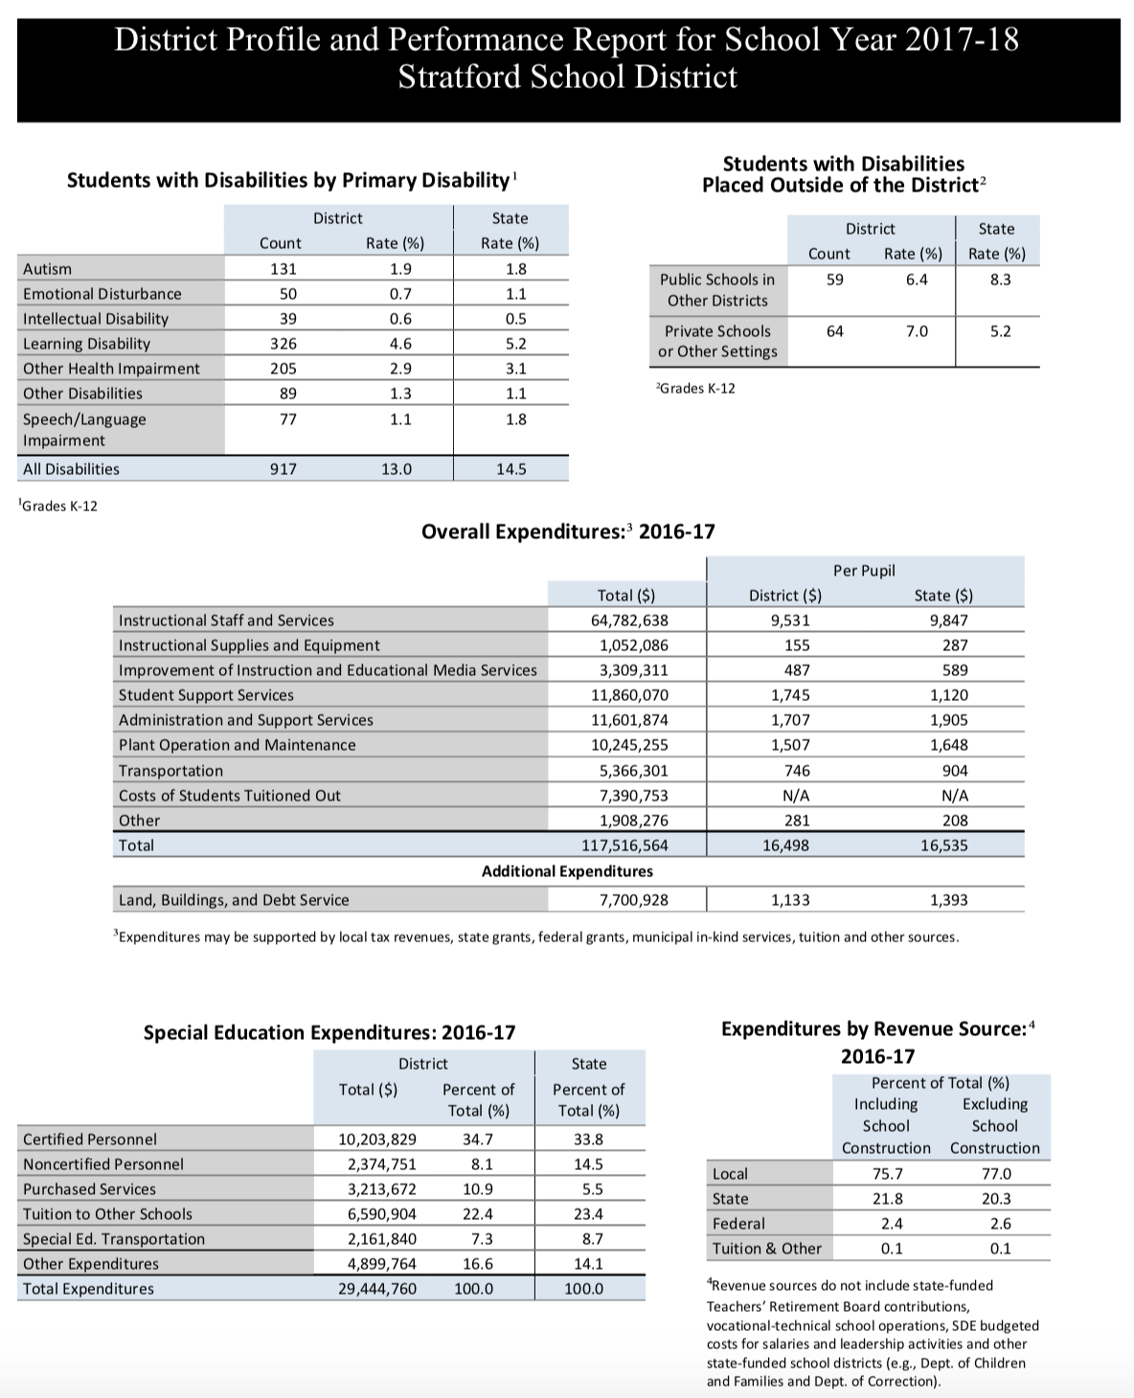

Slide 25
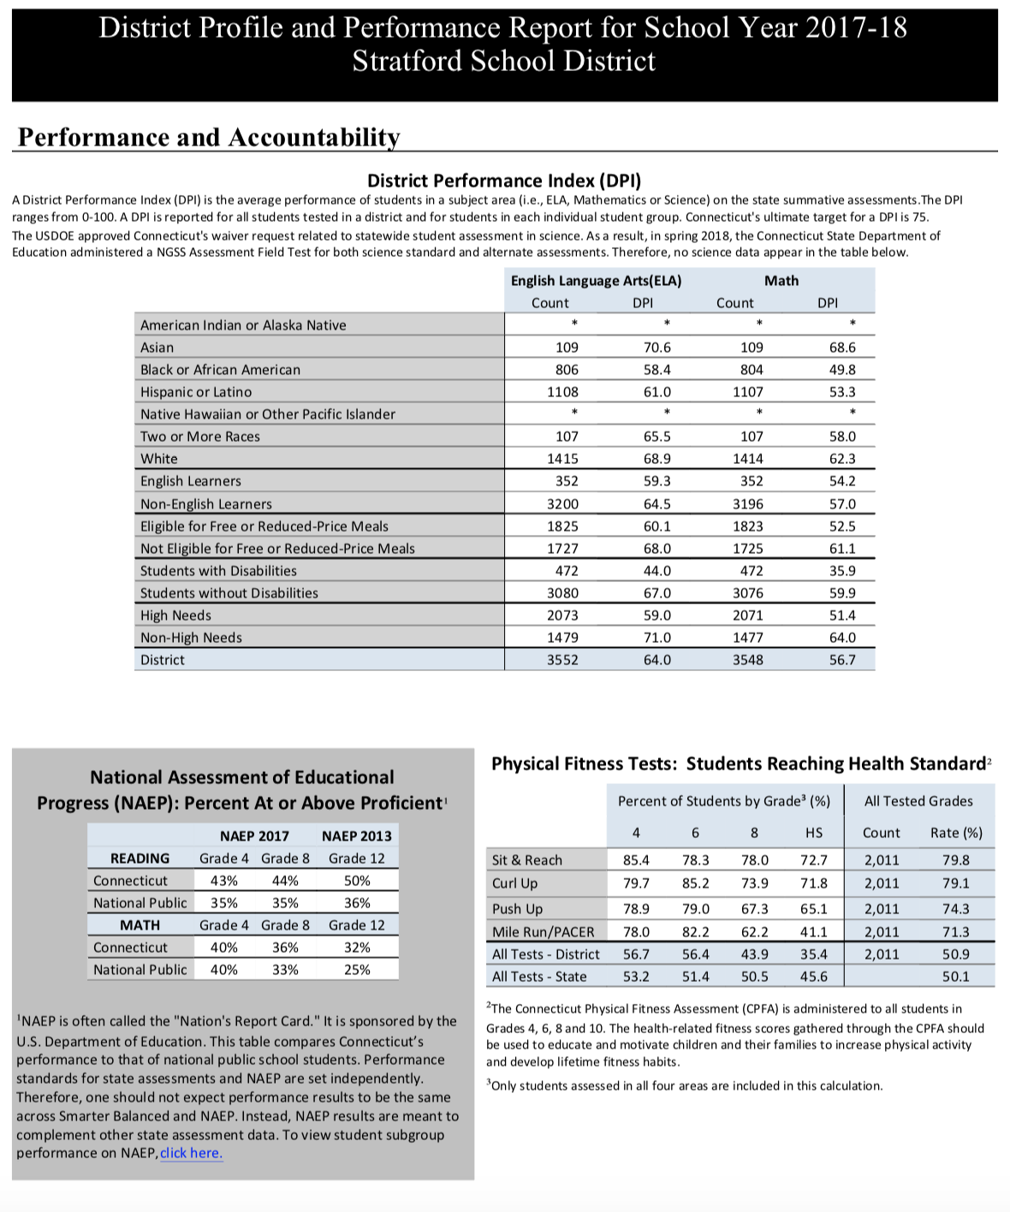

Slide 26
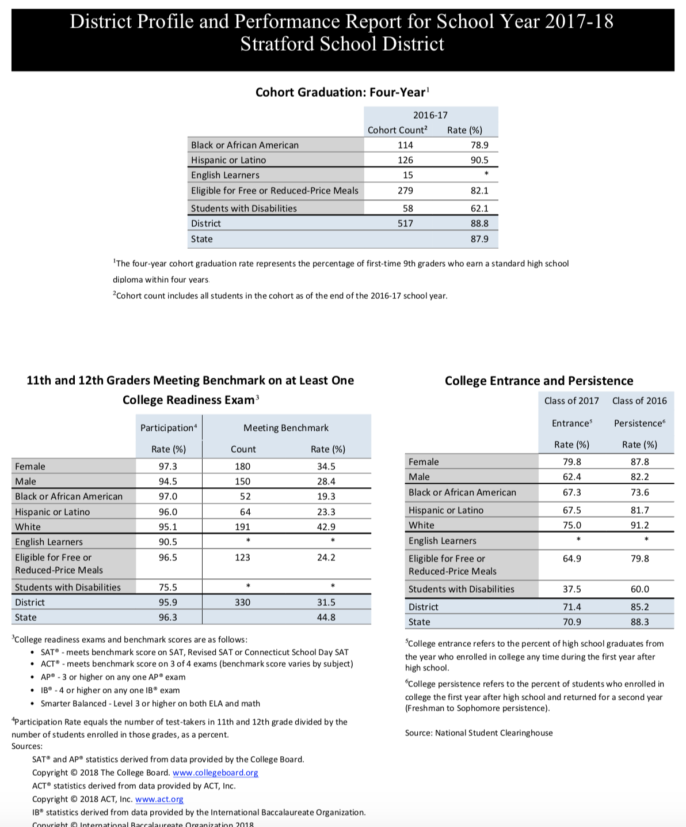
11th & 12th Graders Meeting Benchmark on at Least One College Readiness Exam
White 42.9%
Hispanic 23.3%
Black 19.3%

Slide 27
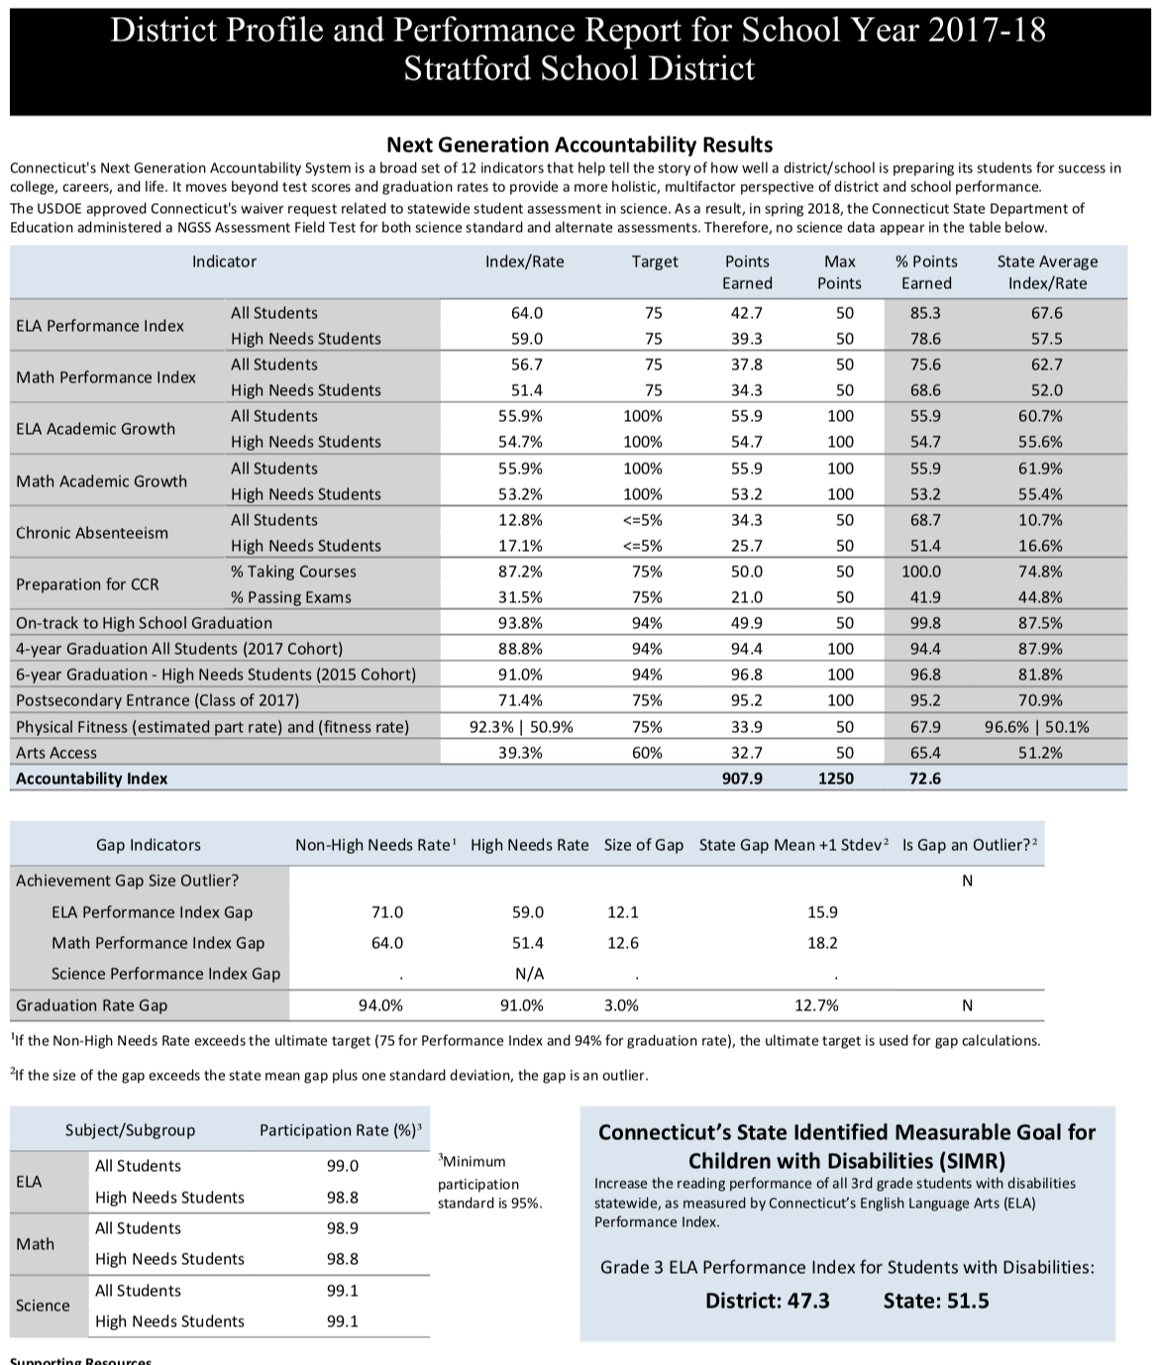

Slide 30
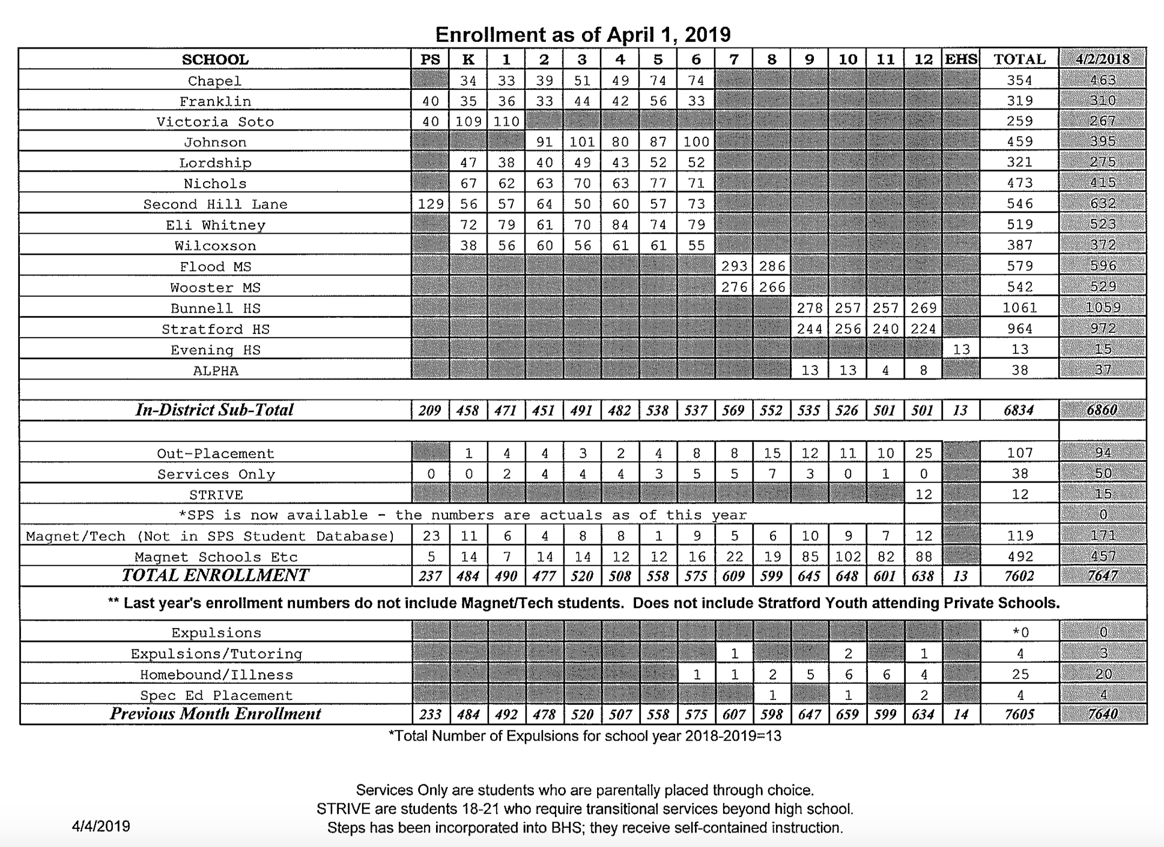

Slide 31
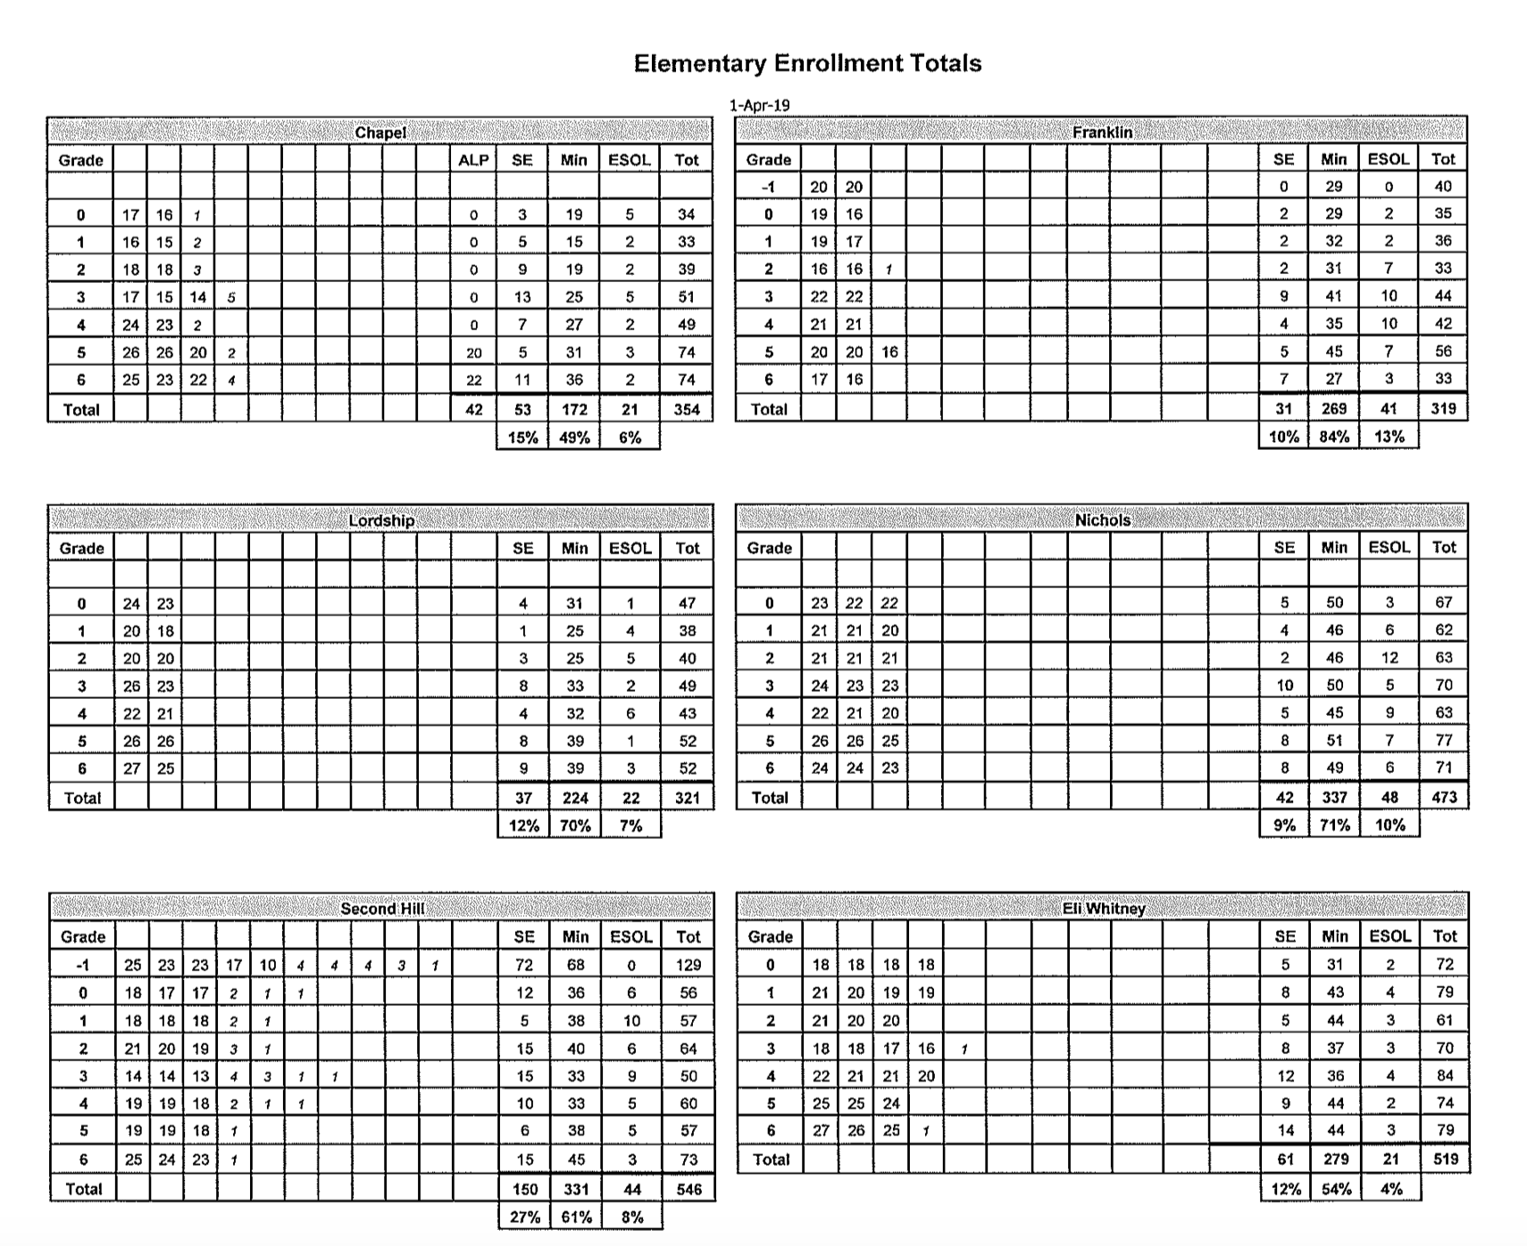

Slide 32
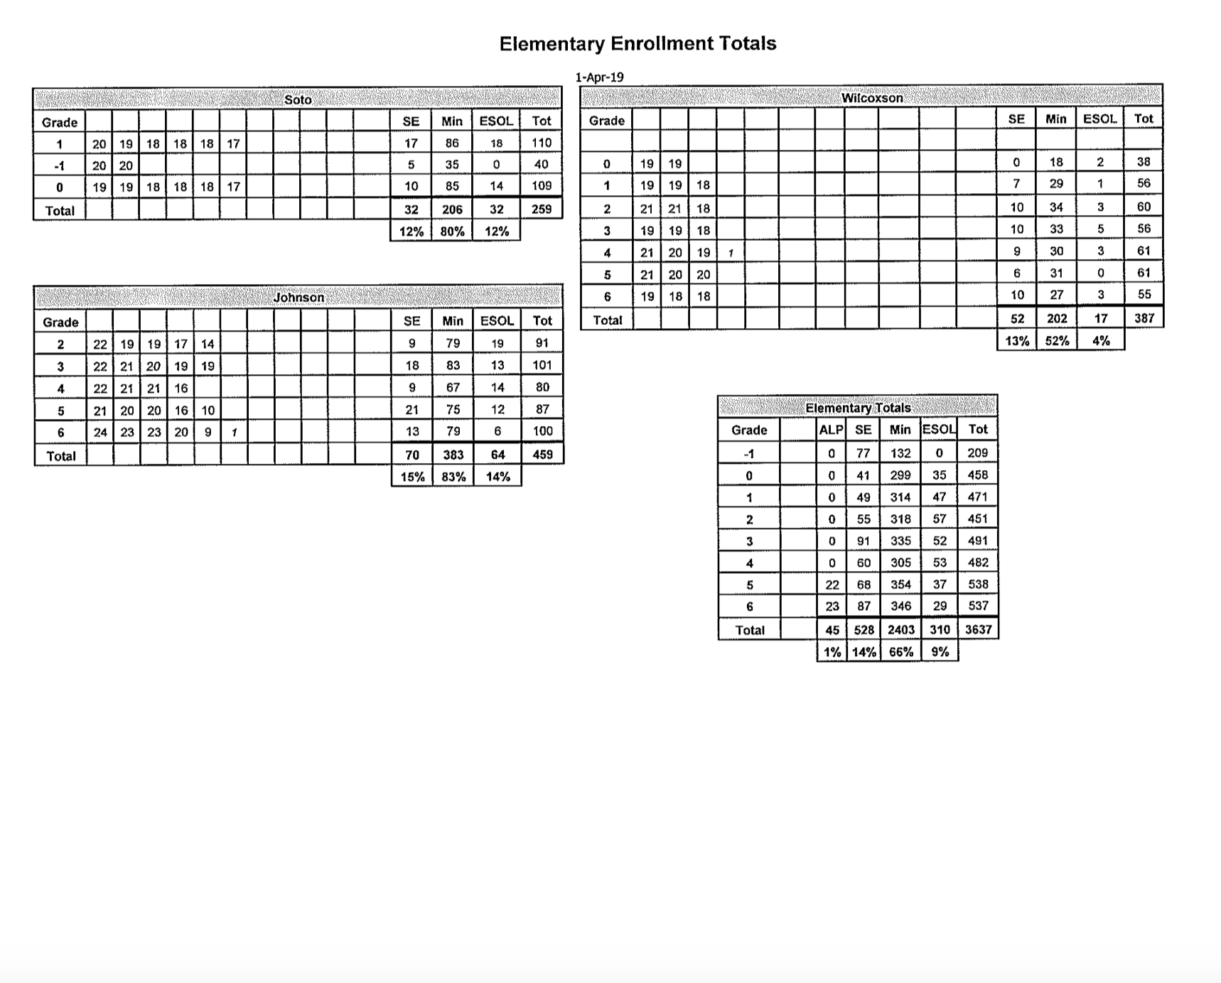

Slide 33
